Slide 1
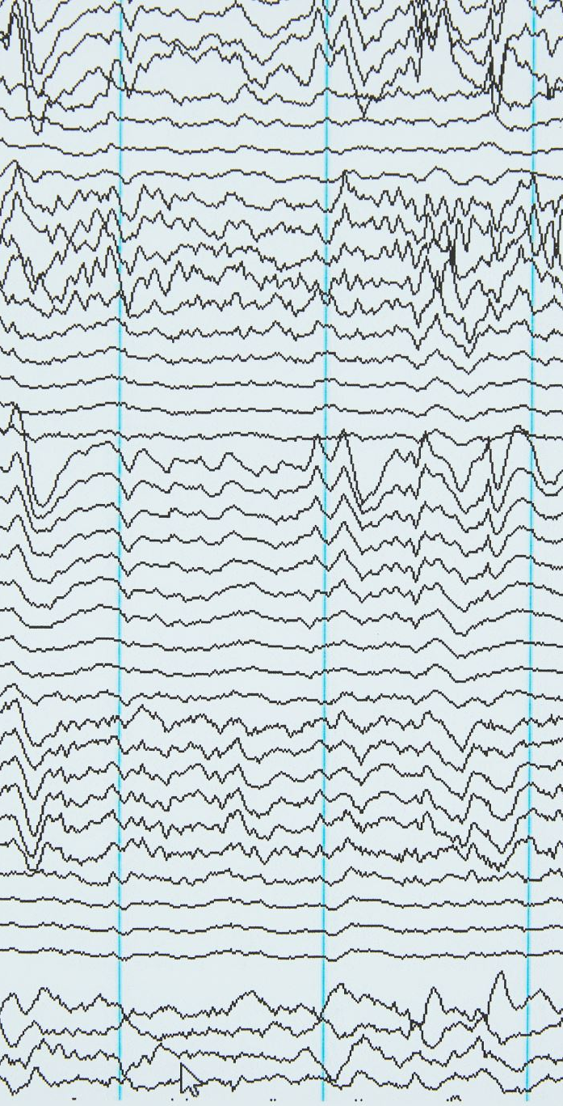
Audio Emotion Recognition Project
Voice-based Emotion Classification with Data Augmentation Aditya Naredla - 16383871

Slide 2
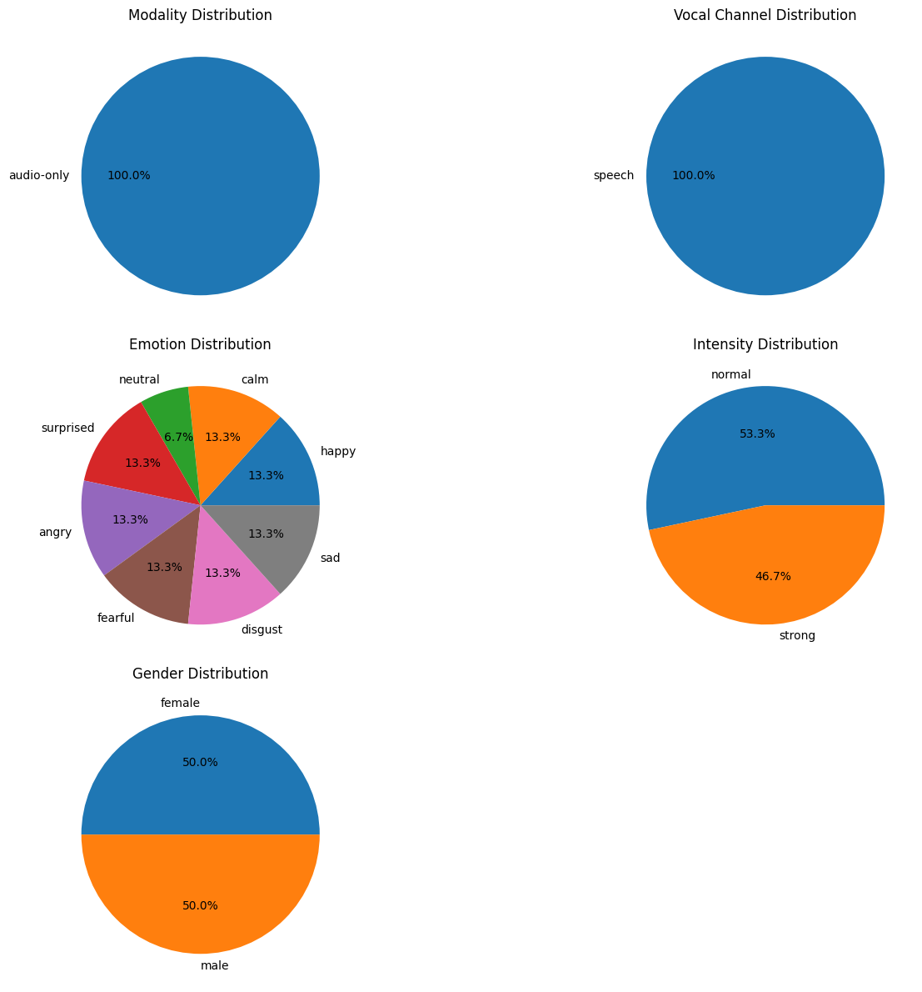
Dataset Distributions

Slide 3
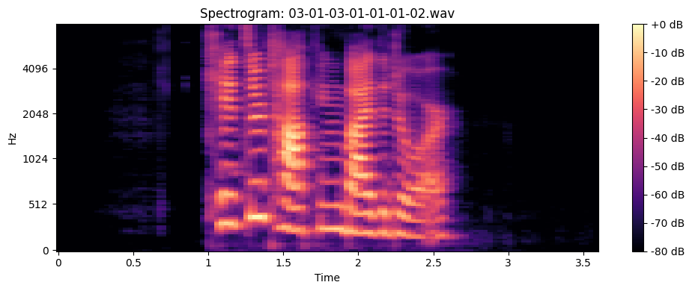
Sample Spectrogram

Slide 4
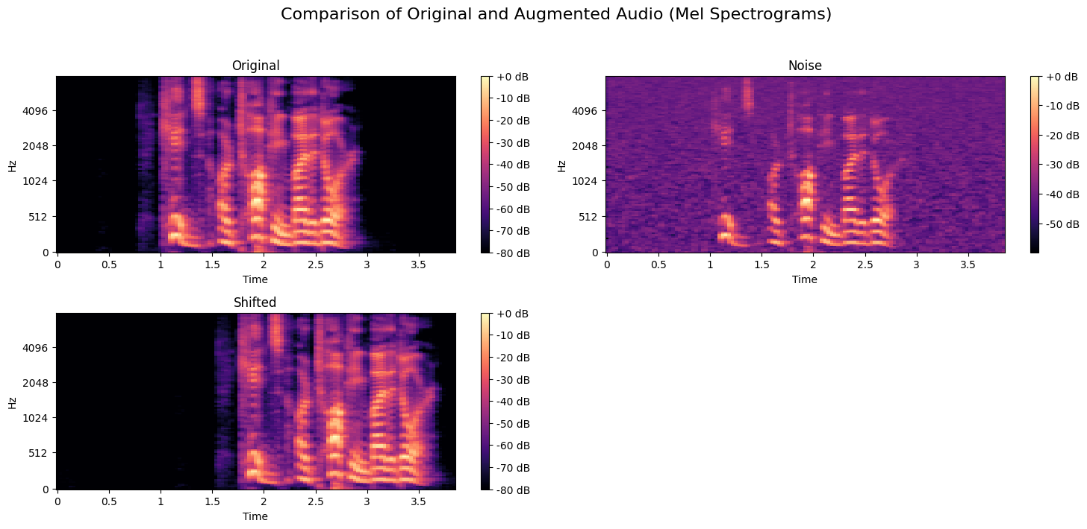
Augmentation Comparison

Slide 5
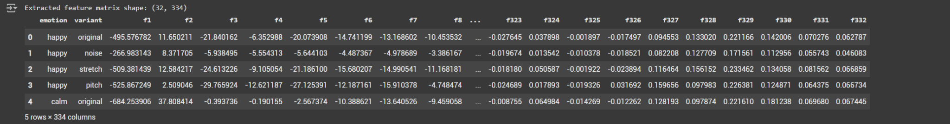
Extracted Feature Matrix

Slide 6
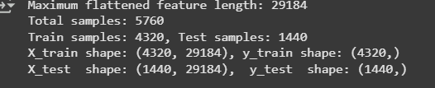
Train-Test Split and Sample Shape

Slide 7
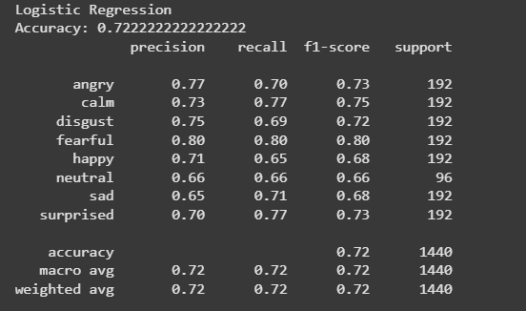
Logistic Regression - Classification Report

Slide 8
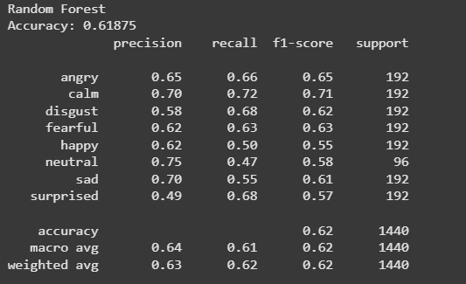
Random Forest - Classification Report

Slide 9
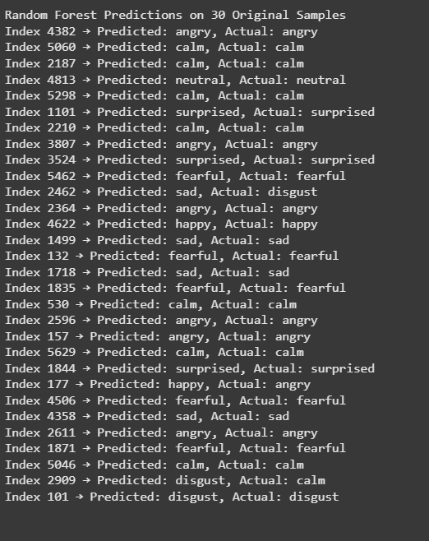
Random Forest - Predictions on Original Samples

Slide 10
Conclusion
• Audio data was analyzed for emotion recognition using spectrogram-based features.
• Dataset was balanced across gender and emotional categories.
• Data augmentation techniques (noise, pitch shift) helped improve model robustness.
• Visualization techniques like mel spectrograms made feature differences interpretable.

